Slide 1



Solana PROFESSIONAL EDUCATION
SOLANA FOUNDATION
Notes:
INSTRUCTOR: Remember to slow down when giving the presentation! Keep this slide on while greeting students
Show them where breakfast is, bathrooms, etc.

Slide 2
SETUP CHECK
Notes:
Ask students:
WSL2 and Windows Terminal
node.js 18 or 20
(Solana CLI tools aren't necessary at this point)

Slide 3
SETUP CHECK
macOS, Linux, Windows laptop
Windows must have WSL2 and Windows Terminal
nodejs 18 or 20
node --version
In person: Telegram for desktop
(we'll use this to send our wallet
addresses to each other)
Notes:
Ask students:
WSL2 and Windows Terminal
node.js 18 or 20
(Solana CLI tools aren't necessary at this point) NOTE: if a student has trouble during setup, ask the other students to do intros while the student sets up.

Slide 4
INTRODUCTIONS
Notes:
Ask students:
their name
where they work / study
why they’re interested in blockchain, or any experience
STUDENTS GO FIRST! Pick a student to start.

Slide 5


CRYPTO
Notes:
Crypto starts with cryptography

Slide 6

LESSON 1: INTRODUCTION TO
CRYPTO
GRAPHY

Slide 7
SYMMETRIC CRYPTO
Notes:
Cryptography started in ancient Egypt, 5-7000 years ago!
The earliest crypto was was we now call "symmetric cryptography".

Slide 8
SENDER AND RECIPIENT
DECIDE a secret

Slide 9
SENDER AND RECIPIENT
DECIDE a secret
sender encrypts
USING THE secret

Slide 10
SENDER AND RECIPIENT
DECIDE a secret
sender encrypts
USING THE secret
RECIPIENT DECRYPTS
USING THE SAME SECRET
Notes:
Examples of symmetric cryptography: Mary Queen of Scots in the tower of London - sent messages to her guards using a symmetric cipher
The Axis powers in WW2 with the enigma machine

Slide 11
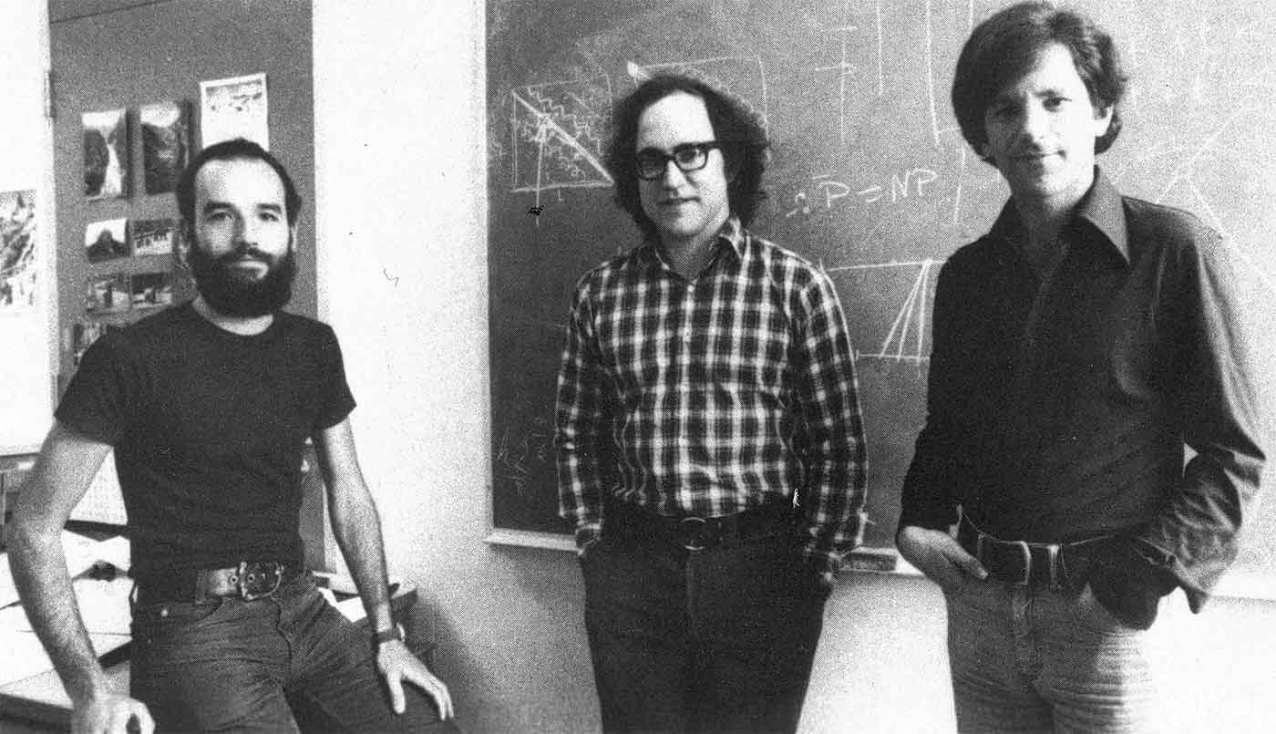
DISK ENCRYPTION
SYMMETRIC ENCRYPTION EXAMPLE:

Slide 12
ASYMMETRIC CRYPTO
Notes:
Symmetric cryptography was all of cryptography until the 1970s, when asymmetric cryptography was introduced by these 3 gentlemen: Rivest, Shamir, Adleman
Also Clifford Cocks in the UK!

Slide 13
Sender and recipient
EACH have a keypair:
A public key
they can show to everyone
A private key
WHICH IS kepT secret

Slide 14
ASYMMETRIC
ENCRYPTION
SENDER ENCRYPTS DATA
WITH RECIPIENT’S PUBLIC KEY
RECIPIENT DECRYPTS DATA,
USING THEIR PRIVATE KEY.

Slide 15
ASYMMETRIC ENCRYPTION EXAMPLE:
WEBSITES
Notes:
How do you stop the person that runs your Wifi or ISP from knowing your passwords?
When you visit a website, the website presents a certificate that includes a public key
Your logins, passwords etc are sent to that website encrypted with the websites public key, so only the website - which has the matching private key - can read them.
* note: we are ignoring TLS session keys to simplify the discussion.

Slide 16
SIGNING
SIGNER ENCRYPTS SOME DATA
WITH THEIR OWN PRIVATE KEY.
ANYONE CAN USE THE
SIGNER’S PUBLIC KEY to
PROVE THE SIGNER SIGNED IT
Notes:
Asymmetric crypto also created digital signatures, and that's the most important part of Solana today.
Signatures allow systems to prove someone did something.

Slide 17
ASYMMETRIC SIGNING EXAMPLE:
PASSPORTS

Slide 18
ASYMMETRIC SIGNING EXAMPLE:
PASSPORTS
ALSO SOLANA TRANSACTIONS!
Notes:
Also SSH! There’s usually a public key installed on servers you SSH into.

Slide 19
LAB
LOADING AND SAVING KEYPAIRS

Slide 20
1. Make a new project
mkdir solana-training
cd solana-training
git init .
npm init -y
npm i @solana/web3.js @solana-developers/helpers esrun
Notes:
Make a new directory, install TypeScript, Solana web3.js and esrun:

Slide 21
2. Make a keypair
generate-keypair.ts
import { Keypair } from "@solana/web3.js";
const keypair = Keypair.generate();
console.log(`✅ Generated keypair!`)
npx esrun generate-keypair.ts
Notes:
Make a new file called generate-keypair.ts
Then run it with esrun.
To make the ✅ emoji: on Mac: ctrl + command + space Windows: win + .

Slide 22
3. Inspect the public and private key
generate-keypair.ts (updated)
import { Keypair } from "@solana/web3.js";
const keypair = Keypair.generate();
console.log(`The public key is: `, keypair.publicKey.toBase58());
console.log(`The secret key is: `, keypair.secretKey);
console.log(`✅ Finished!`);
npx esrun generate-keypair.ts
Notes:
Update the file and run it again.

Slide 23
4. Make an .env file
.env
SECRET_KEY="[
128, 166, 168, 193, 245, 44, 59, 104, 191, 31,
234, 44, 94, 240, 73, 226, 167, 218, 120, 123,
100, 217, 143, 131, 240, 117, 3, 133, 104, 97,
221, 192, 63, 247, 49, 204, 178, 219, 103, 184,
240, 179, 100, 205, 229, 87, 193, 135, 159, 117,
114, 238, 250, 53, 147, 116, 130, 199, 143, 120,
62, 15, 23, 15
]"
Notes:
Update the file and run it again.

Slide 24
5. Load the keypair from the .env file:
npm i dotenv
load-keypair.ts
import "dotenv/config";
import { getKeypairFromEnvironment } from "@solana-developers/helpers";
const keypair = getKeypairFromEnvironment("SECRET_KEY");
console.log(
`✅ Finished! We've loaded our keypair securely, using an env file! Our public key is: ${keypair.publicKey.toBase58()}`
);
npx esrun load-keypair.ts
Notes:
Note how we got the keypair back from the private key - we only need to save the private key!

Slide 25
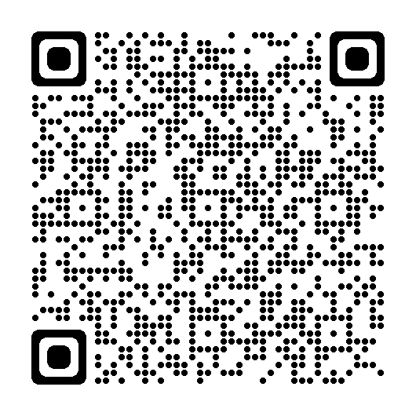
Lesson 1 feedback
Let us know what you think!

Slide 26
LESSON 2: READ DATA FROM
THE NETWORK

Slide 27

Notes:
So how does this relate to Solana?

Slide 28


Ed25519 Curve
Notes:
This curve is the 'Ed' in Ed25519.

Slide 29
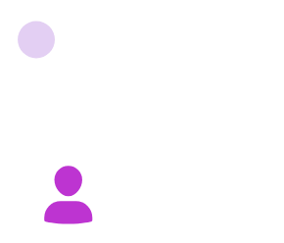
(the matching private key is stored securely on Alice's device)
Notes:
Say we have Alice. And Alice has a keypair. The public key will be somewhere n the Ed25519 curve.

Slide 30
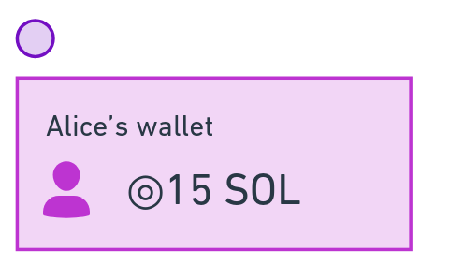
Notes:
In Solana we use public keys as an address.
Alice uses the matching private key to sign transactions.

Slide 31
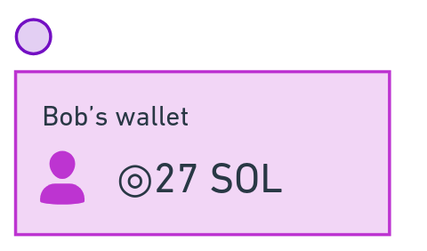
Notes:
Everyone on Solana has at least one keypair, and the pubkey is used as their address

Slide 32
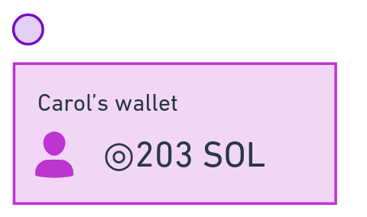
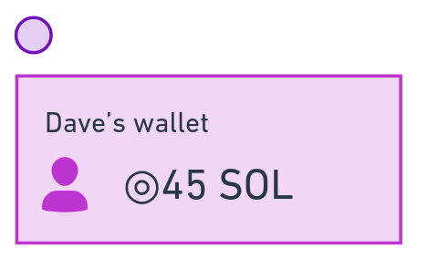
Not overlapping transactions
don't delay each other
Alice sends Bob 10 SOL, says 'thanks'
Carol sends Dave 60 SOL
Notes:
Transactions that don’t overlap can be processed at the same time
This seems obvious, but older blockchains generally wait for transactions to complete in order. This makes them very slow.

Slide 33
Financial Programming 101
Do math in minor units to avoid rounding errors!
Major Units | Minor Units | Decimals
US dollars | Cents | 2
British Pounds (GBP) | Pence | 2
SOL | Lamports | 9
Notes:
Here's something you should know when handling money with computers - whether you're talking about Blockchain or not.
Always do your transactions in minor units to avoid decimal rounding errors.
So do your transaction in cents for USD, pence for GBP, and... lamports for SOL!

Slide 34
Solana has multiple clusters
testnet | The future | Free SOL airdrops
mainnet-beta | Production | No free SOL airdrops
devnet | Shared network for most development purposes | Free SOL airdrops
localnet | localhost validator included with Solana CLI | Free SOL airdrops

Slide 35
LAB
USING SOLANA DEVNET

Slide 36
1. Connect to devnet
check-balance.ts
import "dotenv/config";
import {
Connection,
LAMPORTS_PER_SOL,
PublicKey,
clusterApiUrl,
} from "@solana/web3.js";
const connection = new Connection(clusterApiUrl("devnet"));
console.log(`⚡️ Connected to devnet`);
const publicKey = new PublicKey("YOUR_PUBLIC_KEY_HERE");
Continued on next page...
Notes:
Make a new file called check-balance.ts
We're not going to load the keypair from a file this time, but instead paste in your public key. We'll explain why later.

Slide 37
2. Check the balance
check-balance.ts (continued)
import "dotenv/config";
import {
Connection,
LAMPORTS_PER_SOL,
PublicKey,
clusterApiUrl,
} from "@solana/web3.js";
const connection = new Connection(clusterApiUrl("devnet"));
console.log(`⚡️ Connected to devnet`);
const publicKey = new PublicKey(YOUR_PUBLIC_KEY_HERE);
const balanceInLamports = await connection.getBalance(publicKey);
const balanceInSOL = balanceInLamports / LAMPORTS_PER_SOL;
console.log(
`💰 Finished! The balance for the wallet at address ${publicKey} is ${balanceInSOL}!`
);
npx esrun check-balance.ts
Notes:
Extend the file

Slide 38
3. Airdrop some SOL!
Either use the Solana Faucet:
faucet.solana.com/
import {
getKeypairFromEnvironment,
airdropIfRequired,
} from "@solana-developers/helpers";
...
await airdropIfRequired(
connection,
publicKey,
1 * LAMPORTS_PER_SOL,
0.5 * LAMPORTS_PER_SOL
);
Or the helper function:

Slide 39
3. Check your balance again
npx esrun check-balance.ts
Notes:
Make a new file called generate-keypair.ts
Then run it with esrun

Slide 40
4. Check other people's balances
Join this Telegram group: https://t.me/+ro8_m3J1X7E2NDQ8
Update check-balance.ts to check someone else's balance
Run it again!

Slide 41
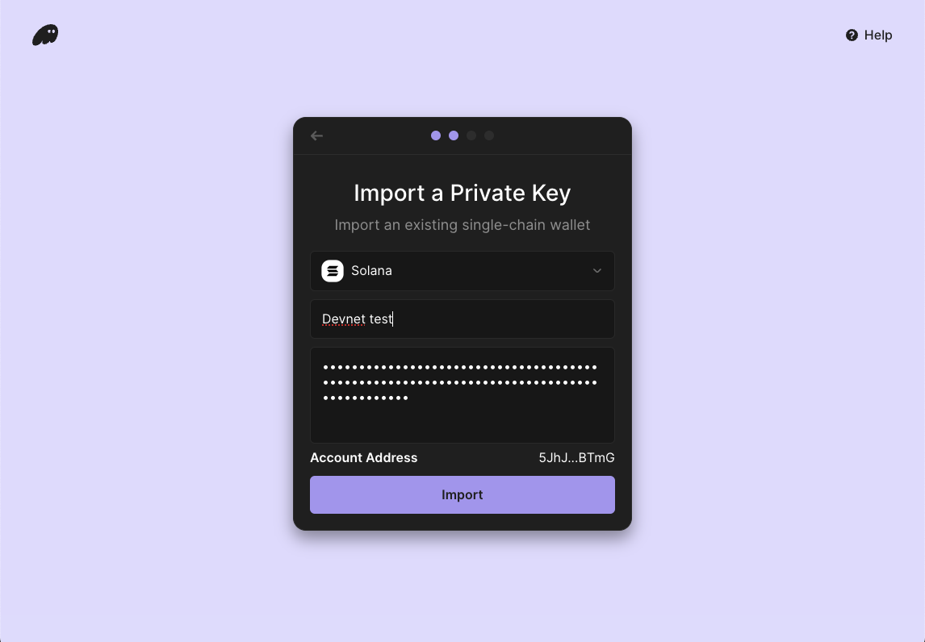
Bonus
export-keypair-tobase58.ts
import "dotenv/config";
import { getKeypairFromEnvironment } from "@solana-developers/helpers";
import bs58 from "bs58";
const keypair = getKeypairFromEnvironment("SECRET_KEY");
console.log(
`✅ Finished! Our secret key in base58 is: ${bs58.encode(keypair.secretKey)}`
);
Import your key into Phantom 1/2
Export your private key in base58 format
Add Phantom browser extension
Pick 'Import Private Key'
npx esrun export-keypair-tobase58.ts
Notes:
Ask the class if they want to set up a devnet wallet.

Slide 42
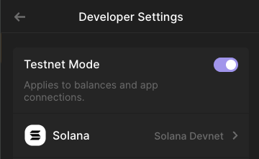
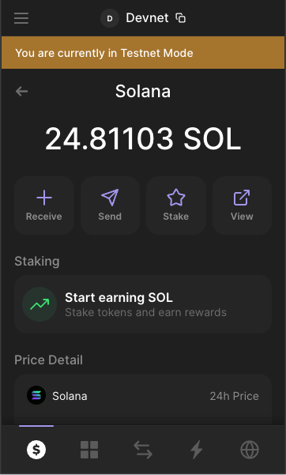
Bonus
Import your key into Phantom 2/2
Settings ⭢ Developer Settings ⭢ Testnet mode (this defaults to Devnet for Solana)
Phantom will now show your Devnet holdings.
Note Phantom shows '-' for your total worth as this is Devnet!
Notes:
Ask the class if they want to set up a devnet wallet.

Slide 43
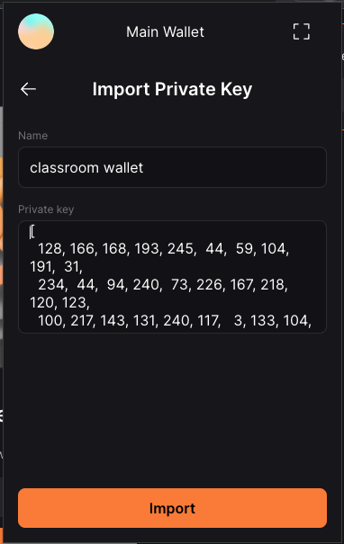
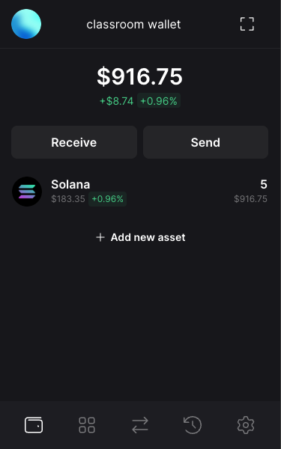
Bonus
Import your key into Solflare
Add Solflare browser extension and follow normal setup including adding a wallet
Top left icon ⭢ + ⭢ Import Private Key in Solflare
Import your private key from your .env file
Settings ⭢ General ⭢ Network ⭢ DevNet
Notes:
Ask the class if they want to set up a devnet wallet.

Slide 44
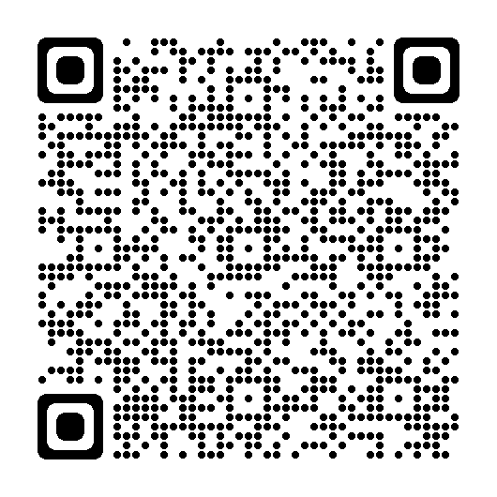
Lesson 2 feedback
Let us know what you think!

Slide 45
LESSON 3: RUN
TRANSACTIONS

Slide 46
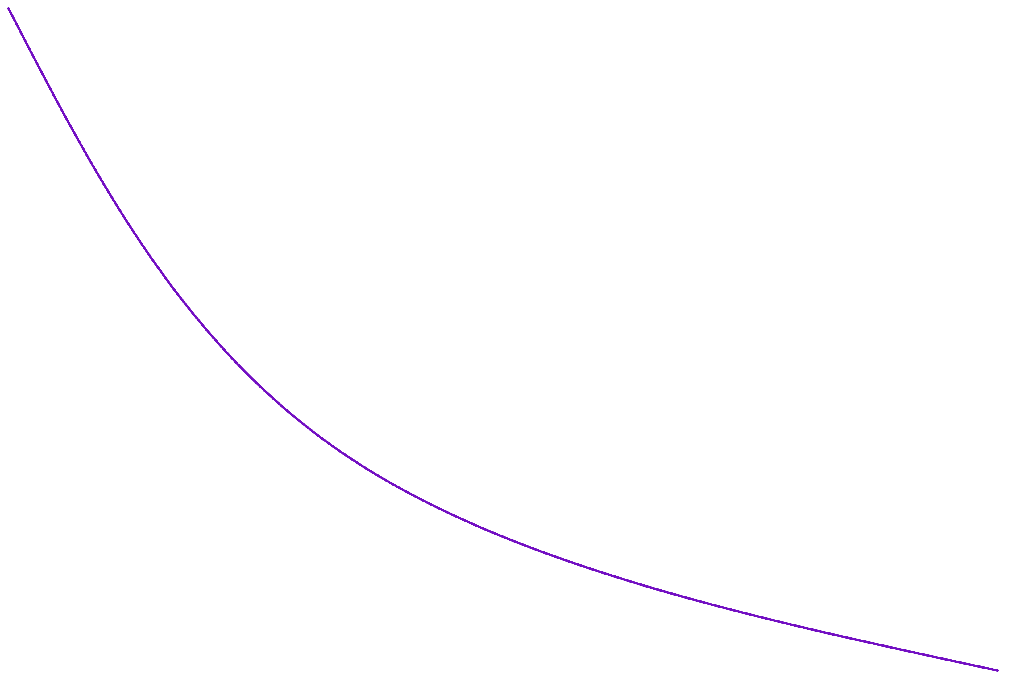
Notes:
Back to alice and bob

Slide 47



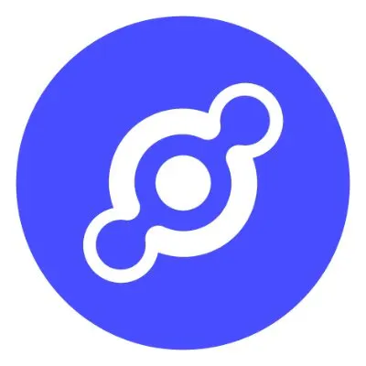









Solana is a
giant global computer
Programs that run on Solana are called onchain programs

Slide 48
Programs that run on Solana are called onchain programs
Notes:
The programs that create tokens, swap tokens, art marketplaces, escrows, market makers, DePIN apps, auctions, retail payments platforms, etc - are called Solana programs.
Called 'Smart Contracts' in older blockchains
https://github.com/solana-labs/explorer/blob/master/app/utils/programs.ts#L107

Slide 49
mv3ekLzLbnVPNxjSKvqBpU3ZeZXPQdEC3bp5MDEBG68
FsJ3A3u2vn5cTVofAjvy6y5kwABJAqYWpe4975bi2epH
metaqbxxUerdq28cj1RbAWkYQm3ybzjb6a8bt518x1s
onchain programs have addresses
9W959DqEETiGZocYWCQPaJ6sBmUzgfxXfqGeTEdp3aQP
EhhTKczWMGQt46ynNeRX1WfeagwwJd7ufHvCDjRxjo5Q
So1endDq2YkqhipRh3WViPa8hdiSpxWy6z3Z6tMCpAo
Notes:
Programs have addresses, too.
A program address itself is just the program, not its data.
Memory on your computer works the same way - programs are separated from data.
Well-known programs are: system, token, token extensions program, metaplex, jupiter

Slide 50
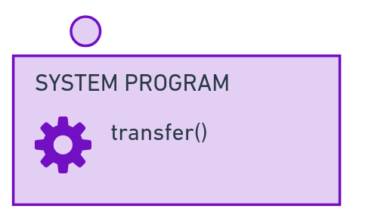

Alice will send Bob 10 SOL
And say thanks!
Notes:
If Alice wants to send Bob 10 SOL, she will:
Use the System program, which has a transfer() function to send SOL Use the Memo program, which has a memo() function to write a small message as part of the transaction

Slide 51
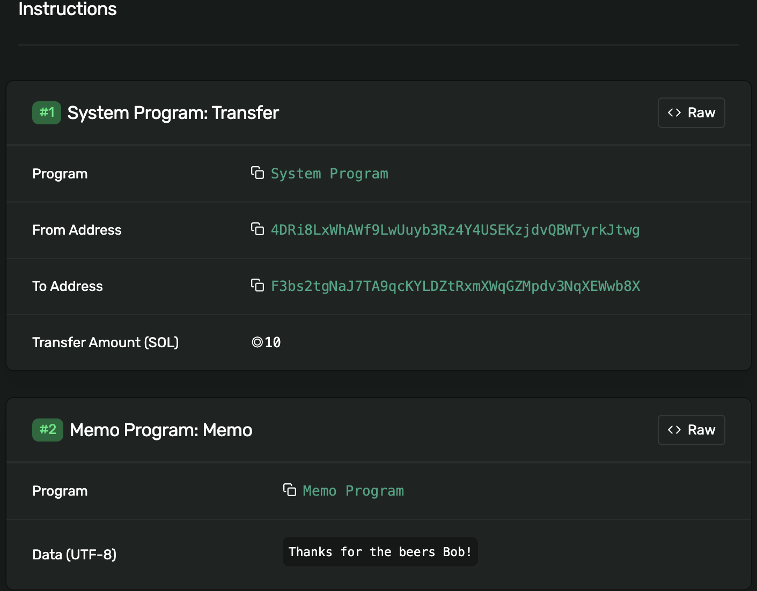
Solana Explorer
ALICE SENDS BOB 10 SOL,
SAYS THANKS
Alice will send Bob 10 SOL
And say thanks!
Notes:
Here’s the transaction in Solana Explorer - you can see the two instructions inside!

Slide 52
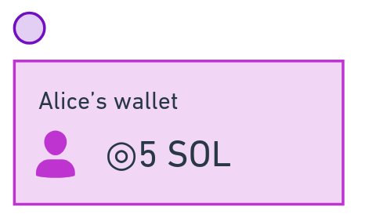

The transaction completes - 10 SOL was transferred from Alice to Bob, and "Thanks!" is written to the logs.
Notes:
If both instructions complete, 10 SOL is now sent to Bob.

Slide 53
LAB
TRANSACTIONS & SENDING SOL

Slide 54
1. Load the keypair and connect to devnet (again!)
send-sol.ts
import "dotenv/config";
import { getKeypairFromEnvironment } from "@solana-developers/helpers";
import {
LAMPORTS_PER_SOL,
PublicKey,
SystemProgram,
Transaction,
clusterApiUrl,
Connection,
sendAndConfirmTransaction
} from "@solana/web3.js";
const sender = getKeypairFromEnvironment("SECRET_KEY");
const connection = new Connection(clusterApiUrl("devnet"));
console.log(
`🔑 Loaded our keypair securely, using an env file! Our public key is: ${sender.publicKey.toBase58()}`
);
Notes:
Make a new file called send-sol.ts

Slide 55
2. Make a transaction, add an instruction to send 0.01 SOL to a classmate, and run it!
send-sol.ts (continued)
... per previous slide ...
const recipient = new PublicKey(SOMEONE_IN_CLASS);
console.log(`💸 Attempting to send 0.01 SOL to ${recipient.toBase58()}...`);
const transaction = new Transaction();
const sendSolInstruction = SystemProgram.transfer({
fromPubkey: sender.publicKey,
toPubkey: recipient,
lamports: 0.01 * LAMPORTS_PER_SOL,
});
transaction.add(sendSolInstruction);
const signature = await sendAndConfirmTransaction(connection, transaction, [
sender,
]);
console.log(`✅ Transaction confirmed, signature: ${signature}!`);
npx esrun send-sol.ts
Notes:
Extend the file

Slide 56
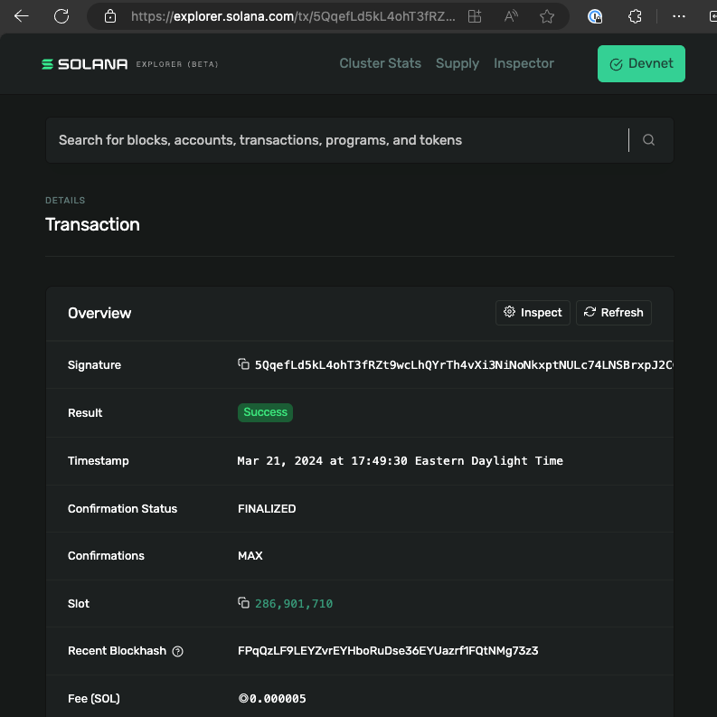
3. Check Solana Explorer
Remember we are using the devnet network.

Slide 57
4. Add a second instruction and run it again!
send-sol.ts (continued)
Add this to your imports:
import { createMemoInstruction } from "@solana/spl-memo";
Add this just after 'transaction.add(sendSolInstruction)'...
const addMemoInstruction = createMemoInstruction("Hello from Solana!");
transaction.add(addMemoInstruction);
console.log(`📝 memo is ${memoText}...`);
npm i@solana/spl-memo
npx esrun send-sol.ts
Notes:
Extend the file

Slide 58
5. Check Solana Explorer again
Remember we are using the devnet network.
What were the fees? What is this in USD?

Slide 59
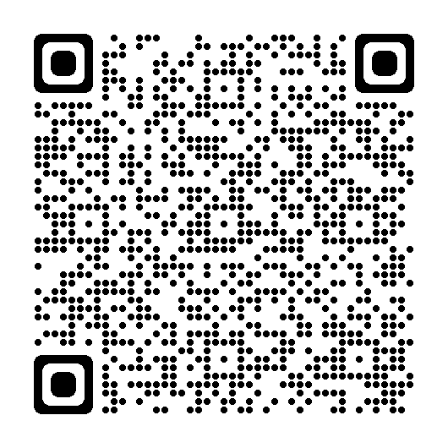
Lesson 3 feedback
Let us know what you think!

Slide 60
LESSON 4: MAKE AND TRANSFER
TOKENS
Notes:
If you get money from family overseas, win a hackathon, or buy snacks at Solana events, you’ll be using USDC rather than SOL.
So how do USDC, PyUSD, Bonk and other non-SOL tokens work?

Slide 61
Notes:
Back to Alice and Bob

Slide 62
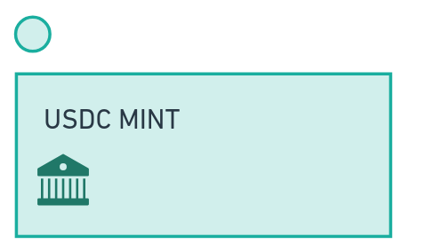
USDC is one one many SPL tokens.
Each token has a unique mint address that
controls the token's supply.
Notes:
Tokens on Solana each have a distinct token mint address, run by the mint authority - the person or organisation that produces the token. The mint is the factory that produces tokens. USDC is produced by Circle, and Circle run the USDC mint at an address they put on their website.

Slide 63
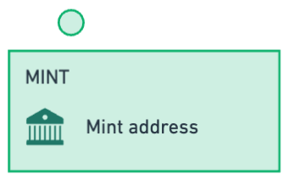

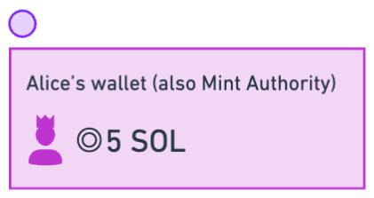
USDC is one one many SPL tokens.
Each token has a unique mint address that
controls the token's supply.
The mint address includes information about the token, including a mint authority - someone allowed to mint new tokens.
Let's mint new tokens and transfer them to Bob!
Notes:
It has a mint authority - someone specified by public key allowed to mint new tokens
It has a freeze authroity - someone specified by public key that can stop new tokens being minted

Slide 64
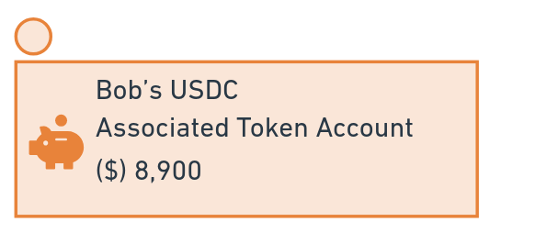
Let's...
Make our own token mint, with our address as the mint authority
Make a PDA for someone to store our tokens
Mint our tokens to their wallet!
A token is uniquely defined by it's mint address
The mint address includes information about the token, including a mint authority - someone allowed to mint new tokens.
Notes:
A token is uniquely defined by it's mint address
It has a mint authority - someone specified by public key allowed to mint new tokens
It has a freeze authroity - someone specified by public key that can stop new tokens being minted

Slide 65
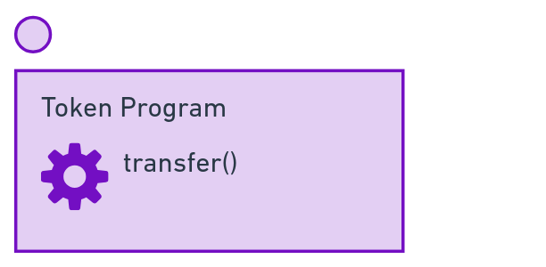
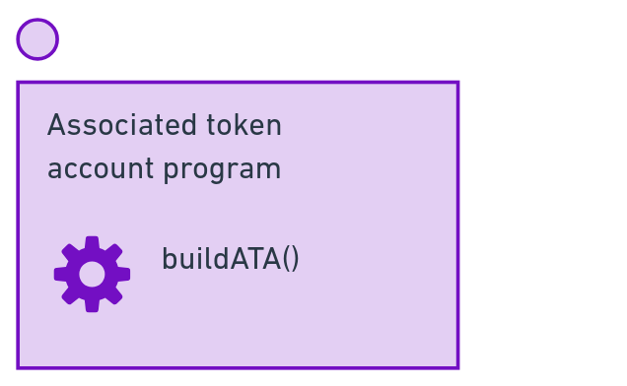

We can transfer SPL tokens just like SOL, except instead of the System Program we use the Token Program to transfer them.
Notes:
Say Alice gets some USDC from Bob.
We can make a transaction with two instructions:
- The associated token program has a buildATA() function. This creates the associated token account if it doesn’t already exist.
- The token account has a transfer() function
Combining those, Alice now has the USDC in account associated with her wallet.

Slide 66
LAB
MAKING A TOKEN MINT,
AND USING IT TO MINT TOKENS

Slide 67
1. Add the @solana/spl-token package
npm i @solana/spl-token

Slide 68
2. Load a keypair and connect
create-token-mint.ts
import { createMint } from "@solana/spl-token";
import "dotenv/config";
import {
getKeypairFromEnvironment,
getExplorerLink,
} from "@solana-developers/helpers";
import { Connection, clusterApiUrl } from "@solana/web3.js";
const connection = new Connection(clusterApiUrl("devnet"));
const user = getKeypairFromEnvironment("SECRET_KEY");
Continued on next page....
Notes:
Extend the file

Slide 69
3. Make a token mint!
create-token-mint.ts continued
...continued
const tokenMint = await createMint(
connection,
user,
user.publicKey,
null,
2
);
const link = getExplorerLink("address", tokenMint.toString(), "devnet");
console.log(`✅ Token Mint: ${link}`);
npx esrun create-token-mint.ts
Notes:
Extend the file

Slide 70
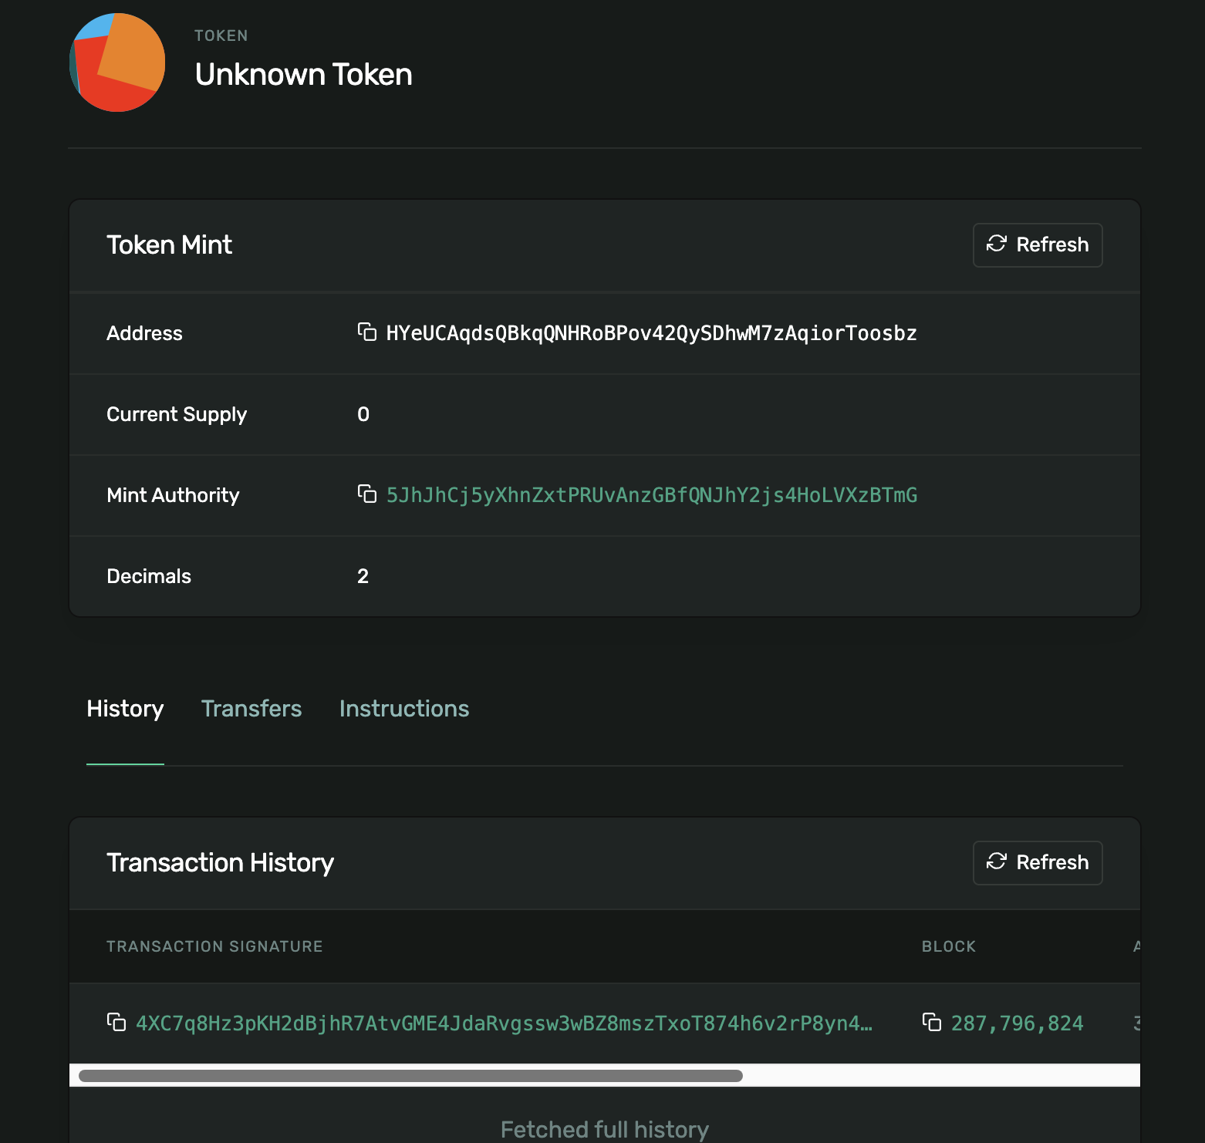
4. Open Solana Explorer
and look at the new Token Mint!

Slide 71
5. Make a token account for a recipient
create-token-account.ts
import { getOrCreateAssociatedTokenAccount } from "@solana/spl-token";
import "dotenv/config";
import {
getExplorerLink,
getKeypairFromEnvironment,
} from "@solana-developers/helpers";
import { Connection, PublicKey, clusterApiUrl } from "@solana/web3.js";
const connection = new Connection(clusterApiUrl("devnet"), "confirmed");
const user = getKeypairFromEnvironment("SECRET_KEY");
console.log(
`🔑 Loaded our keypair securely, using an env file! Our public key is: ${user.publicKey.toBase58()}`
);
continued on next slide...
Notes:
Make an account

Slide 72
6. Make a token account for a recipient continued
create-token-account.ts continued
// Subtitute in your token mint account from create-token-mint.ts
const tokenMintAccount = new PublicKey(
"HYeUCAqdsQBkqQNHRoBPov42QySDhwM7zAqiorToosbz"
);
// Subtitute in a recipient from addresses.ts
const recipient = new PublicKey("Hxsgo2tPiu6967VUaEquk232riDKkaqK89wBvdSCgjH7");
const tokenAccount = await getOrCreateAssociatedTokenAccount(
connection,
user,
tokenMintAccount,
recipient
);
console.log(`Token Account: ${tokenAccount.address.toBase58()}`);
const link = getExplorerLink(
"address",
tokenAccount.address.toBase58(),
"devnet"
);
console.log(`✅ Created token Account: ${link}`);
npx esrun create-token-account.ts
Notes:
Extend the file

Slide 73
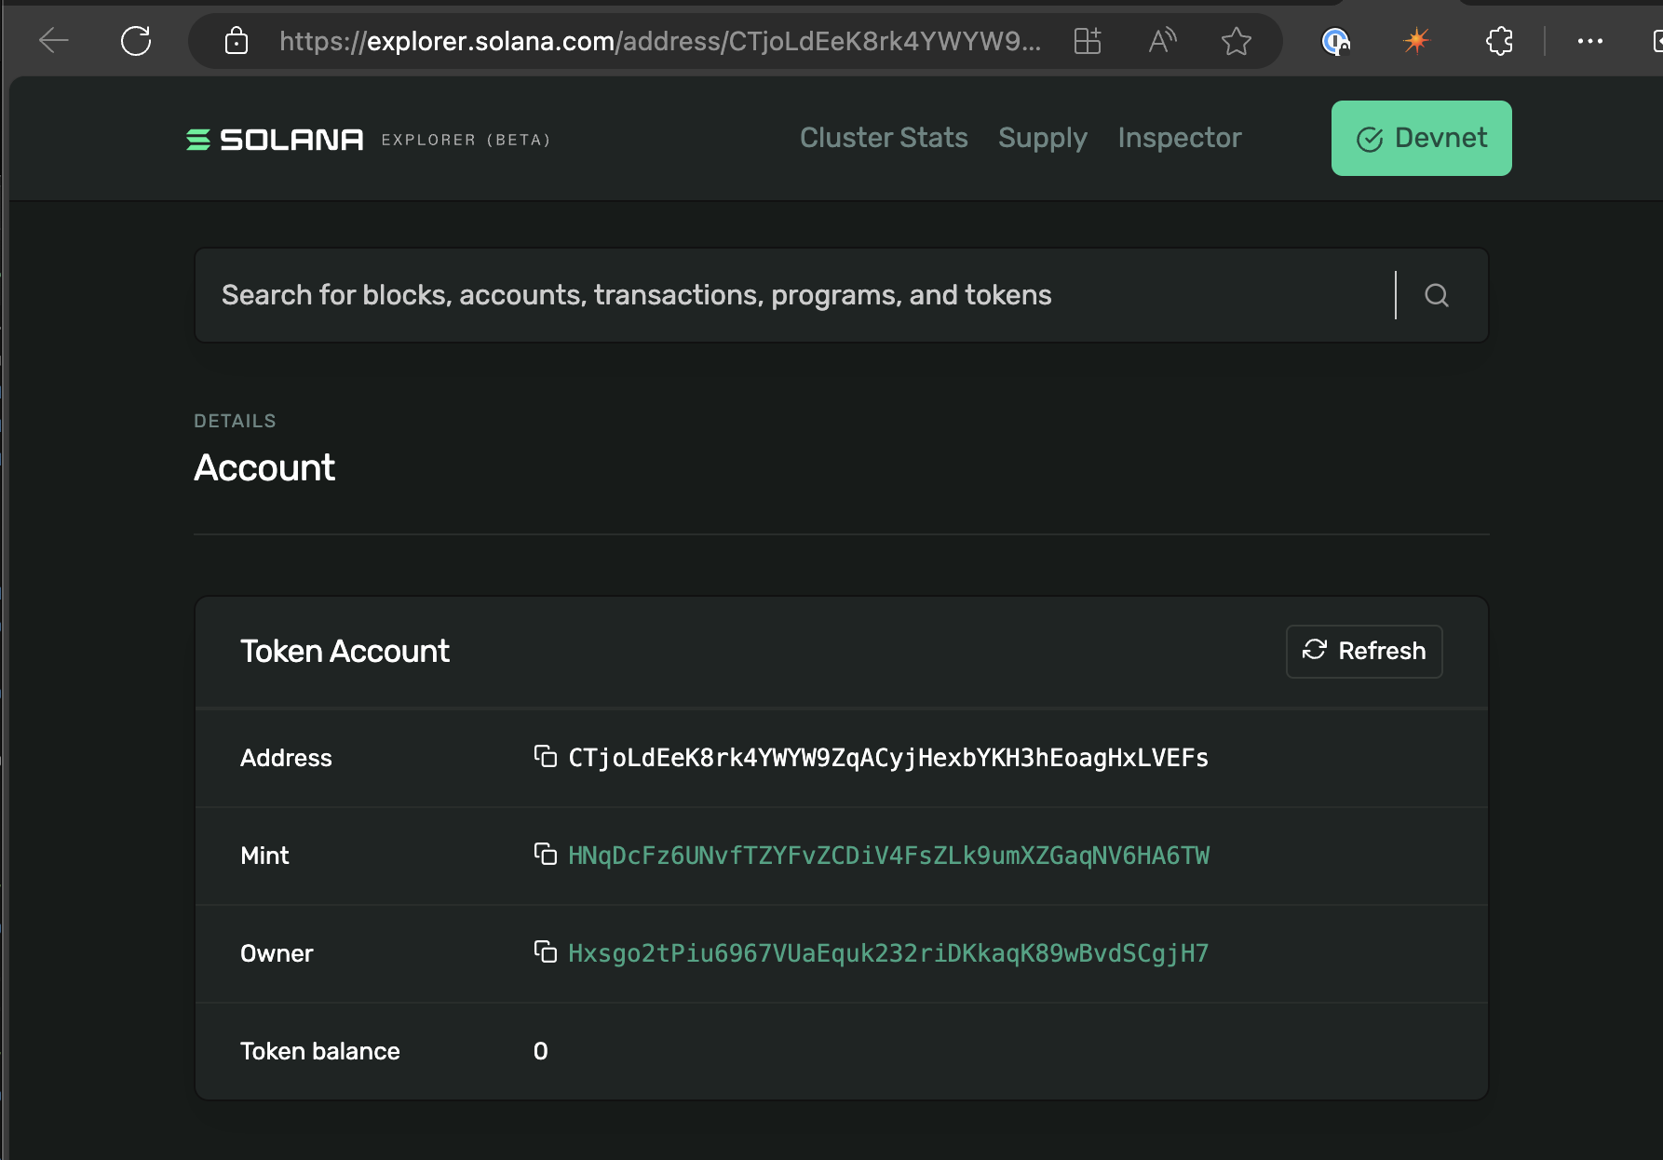
7. Open Solana Explorer and look at the recipient's new associated token account
Who is the owner of the newly created token account?
What is the mint of the newly created token account?

Slide 74
8. Mint tokens!
mint-tokens.ts
import { getOrCreateAssociatedTokenAccount, mintTo } from "@solana/spl-token";
import "dotenv/config";
import {
getExplorerLink,
getKeypairFromEnvironment,
} from "@solana-developers/helpers";
import { Connection, PublicKey, clusterApiUrl } from "@solana/web3.js";
const connection = new Connection(clusterApiUrl("devnet"), "confirmed");
// Our token has two decimal places
const MINOR_UNITS_PER_MAJOR_UNITS = Math.pow(10, 2);
const user = getKeypairFromEnvironment("SECRET_KEY");
// Substitute in your token mint account from create-token-mint.ts
const tokenMintAccount = new PublicKey(
"HNqDcFz6UNvfTZYFvZCDiV4FsZLk9umXZGaqNV6HA6TW"
);
continued on next slide...
Notes:
Let's mint some tokens.

Slide 75
9. Mint tokens (continued)
mint-tokens.ts
// Let's mint the tokens to ourselves for now!
const recipientAssociatedTokenAccount = await getOrCreateAssociatedTokenAccount(
connection,
user,
tokenMintAccount,
user.publicKey
);
const transactionSignature = await mintTo(
connection,
user,
tokenMintAccount,
recipientAssociatedTokenAccount.address,
user,
10 * MINOR_UNITS_PER_MAJOR_UNITS
);
const link = getExplorerLink("transaction", transactionSignature, "devnet");
console.log(`✅ Success! Mint Token Transaction: ${link}`);
npx esrun mint-tokens.ts
Notes:
We can mint the tokens directly to any associated token account - this could be our own ATA, or a classmates. Let's mint to our own token account for now. We can send the tokens to other people later!

Slide 76
10. Open Solana Explorer
Look at the Token Program Mint to Instruction
What is the updated balance of the recipients Asociated Token Account?

Slide 77
11. Send tokens!
send-spl-tokens.ts
import "dotenv/config";
import {
getExplorerLink,
getKeypairFromEnvironment,
} from "@solana-developers/helpers";
import { Connection, PublicKey, clusterApiUrl } from "@solana/web3.js";
import { getOrCreateAssociatedTokenAccount, transfer } from "@solana/spl-token";
const connection = new Connection(clusterApiUrl("devnet"), "confirmed");
const user = getKeypairFromEnvironment("SECRET_KEY");
console.log(
`🔑 Loaded our keypair securely, using an env file! Our public key is: ${user.publicKey.toBase58()}`
);
// Add the recipient public key here
const recipient = new PublicKey("YOUR_RECIPIENT_HERE");
// Subtitute in your token mint account
const tokenMintAccount = new PublicKey("YOUR_TOKEN_MINT_ADDRESS_HERE");
// Our token has two decimal places
const MINOR_UNITS_PER_MAJOR_UNITS = Math.pow(10, 2);
console.log(`💸 Attempting to send 1 token to ${recipient.toBase58()}...`);
continued on next slide...
Notes:
Let's send some tokens. You can any token that you have, to anyone else in the class - you just need to know their wallet address, and the token you want to send.

Slide 78
12. Send tokens (continued)
send-spl-tokens.ts
// Get or create the source and destination token accounts to store this token
const sourceTokenAccount = await getOrCreateAssociatedTokenAccount(
connection,
user,
tokenMintAccount,
user.publicKey
);
const destinationTokenAccount = await getOrCreateAssociatedTokenAccount(
connection,
user,
tokenMintAccount,
recipient
);
// Transfer the tokens
const signature = await transfer(
connection,
user,
sourceTokenAccount.address,
destinationTokenAccount.address,
user,
1 * MINOR_UNITS_PER_MAJOR_UNITS
);
const explorerLink = getExplorerLink("transaction", signature, "devnet");
console.log(`✅ Transaction confirmed, explorer link is: ${explorerLink}!`);
npx esrun send-spl-tokens.ts
Notes:
Send the tokens!

Slide 79
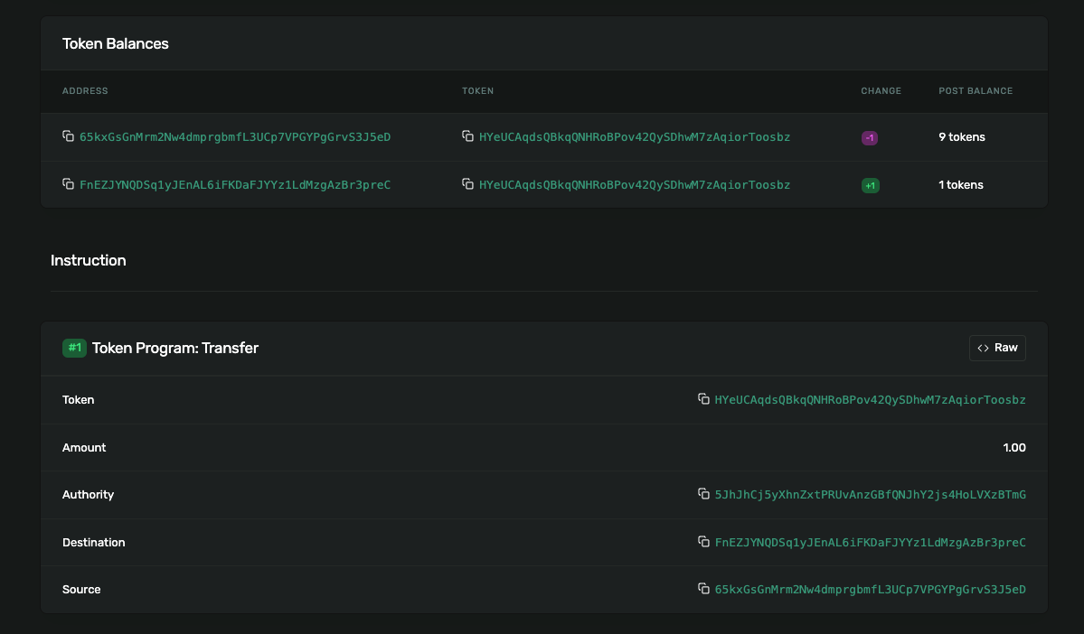
13. Open the transaction in Solana Explorer
What accounts were involved in sending the SPL token?

Slide 80
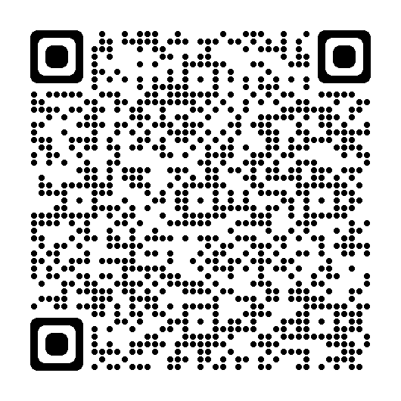
Lesson 4 feedback
Let us know what you think!

Slide 81
LESSON 5: TOKEN
METADATA

Slide 82
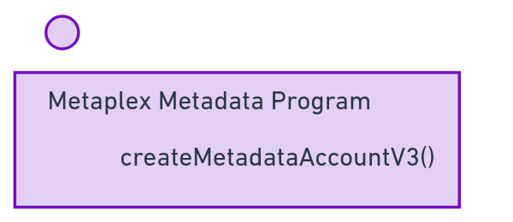
Metaplex adds metadata - additional data, like a name and symbol - for both regular tokens and NFTs.
Let's mint new tokens and transfer them to Bob!

Slide 83
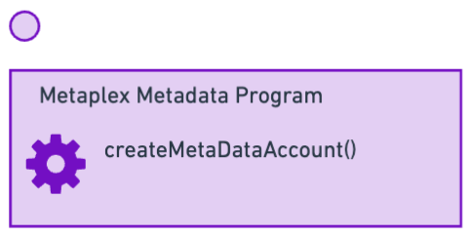
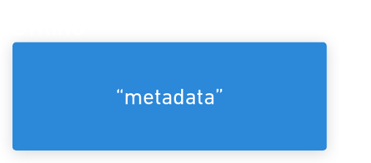
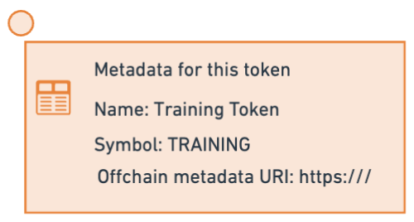
Metaplex adds metadata - additional data, like a name and symbol - for both regular tokens and NFTs.
The metadata is stored in a Solana PDA.
Let's mint new tokens and transfer them to Bob!

Slide 85
LAB
CREATE TOKEN METADATA

Slide 86
1. Install Metaplex version 2
npm i "@metaplex-foundation/mpl-token-metadata@2"

Slide 87
2. Load a keypair and connect
create-token-metadata.ts
// This uses "@metaplex-foundation/mpl-token-metadata@2" to create tokens
import "dotenv/config";
import {
getKeypairFromEnvironment,
getExplorerLink,
} from "@solana-developers/helpers";
import {
Connection,
clusterApiUrl,
PublicKey,
Transaction,
sendAndConfirmTransaction,
} from "@solana/web3.js";
// Yes, createCreate! We're making an instruction for createMetadataV3...
import { DataV2, createCreateMetadataAccountV3Instruction } from "@metaplex-foundation/mpl-token-metadata";
const user = getKeypairFromEnvironment("SECRET_KEY");
const connection = new Connection(clusterApiUrl("devnet"));
console.log(
`🔑 We've loaded our keypair securely, using an env file! Our public key is: ${user.publicKey.toBase58()}`
);
Continued on next page....

Slide 88
3. Set our Metadata
create-token-metadata.ts (continued)
const TOKEN_METADATA_PROGRAM_ID = new PublicKey(
"metaqbxxUerdq28cj1RbAWkYQm3ybzjb6a8bt518x1s"
);
// Subtitute in your token mint account from create-token-mint.ts
const tokenMintAccount = new PublicKey(
"HNqDcFz6UNvfTZYFvZCDiV4FsZLk9umXZGaqNV6HA6TW"
);
const metadataData: DataV2 = {
name: "Solana Training Token",
symbol: "TRAINING",
// Arweave / IPFS / Pinata etc link using metaplex standard for off-chain data
uri: "https://raw.githubusercontent.com/solana-developers/professional-education/main/labs/sample-token-metadata.json",
sellerFeeBasisPoints: 0,
creators: null,
collection: null,
uses: null,
};
Continued on next page....
Notes:
Extend the file

Slide 89
4. Make a PDA to store it
create-token-metadata.ts (continued)
const metadataPDAAndBump = PublicKey.findProgramAddressSync(
[
Buffer.from("metadata"),
TOKEN_METADATA_PROGRAM_ID.toBuffer(),
tokenMintAccount.toBuffer(),
],
TOKEN_METADATA_PROGRAM_ID
);
const metadataPDA = metadataPDAAndBump[0];
const transaction = new Transaction();
const createMetadataAccountInstruction =
createCreateMetadataAccountV3Instruction(
{
metadata: metadataPDA,
mint: tokenMintAccount,
mintAuthority: user.publicKey,
payer: user.publicKey,
updateAuthority: user.publicKey,
},
{
createMetadataAccountArgsV3: {
collectionDetails: null,
data: metadataData,
isMutable: true,
},
}
);
transaction.add(createMetadataAccountInstruction);
Continued on next page....
Notes:
Extend the file

Slide 90
5. Create our Metadata account!
create-token-metadata.ts (continued)
await sendAndConfirmTransaction(
connection,
transaction,
[user]
);
const tokenMintLink = getExplorerLink(
"address",
tokenMintAccount.toString(),
"devnet"
);
console.log(`✅ Look at the token mint again: ${tokenMintLink}!`);
npx esrun create-token-metadata.ts
Notes:
Extend the file

Slide 91
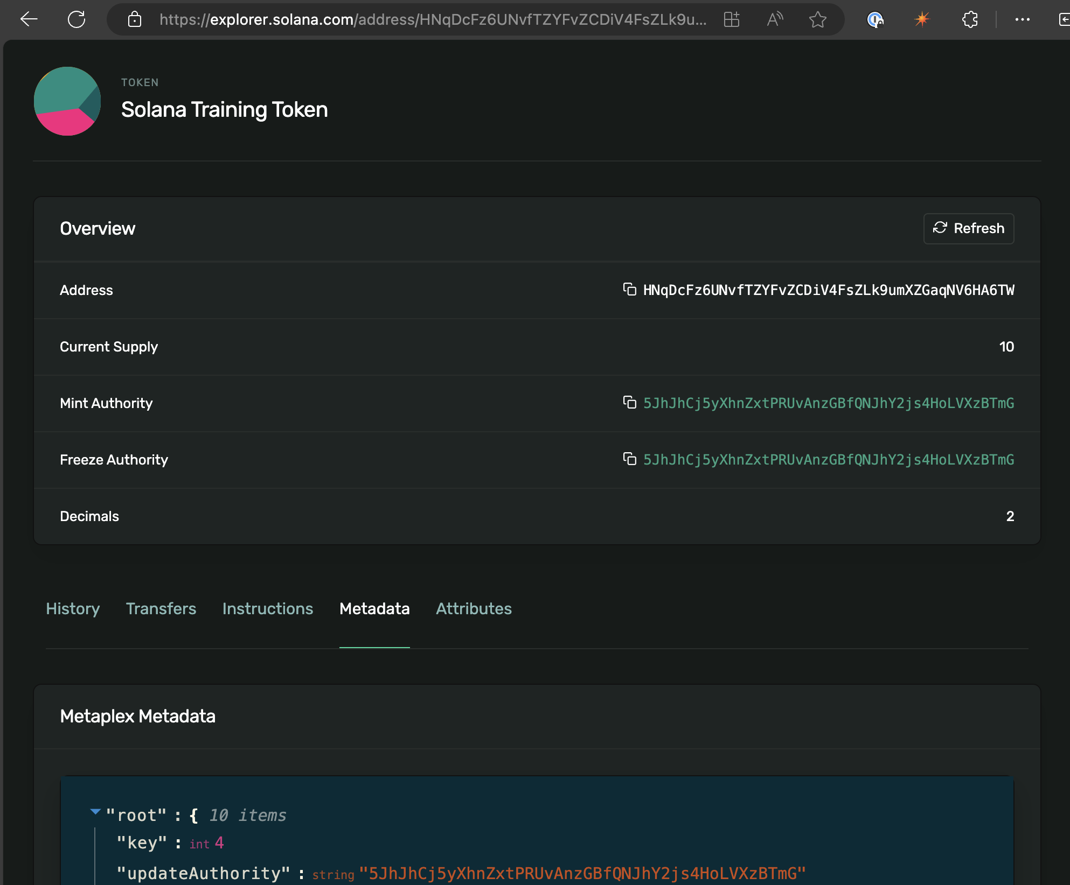
6. Open Solana Explorer
Look at the Token Mint - what changed?
Click the metadata tab of the token mint. What can you see?

Slide 92
Lesson 5 feedback
Let us know what you think!

Slide 93
LESSON 6: INTRO TO
ANCHOR

Slide 94
The most popular way to build onchain apps is using Rust using the Anchor framework.
Notes:
Frameworks for other languages, including TypeScript, Python and Move are coming soon.
These frameworks implement common security checks automatically, and handle common tasks like:
sending incoming instructions to the right instruction handlers
deserialising data from incoming transactions
checking the accounts provided with incoming instructions, for example to check that certain accounts are of a particular type, or are distinct from other accounts.

Slide 95
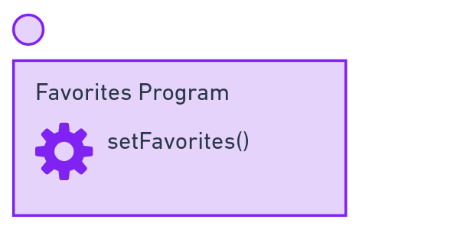
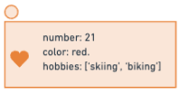
Our first program sets Favorite things using a Program Derived Address to store them.

Slide 96
You might not know Rust, but ...
Most onchain programs are only a few hundred lines.
Onchain programs are often similar to each other! Most Anchor programs only use the first 6 chapters of the Rust book.
The VScode 'Rust Analyzer' extension can help spot errors
Solana Stack Exchange is there to answer your Anchor and Rust questions!
Notes:
If you have VScode, install Rust Analyzer now!

Slide 97
Some important things to know
Anchor instruction handlers write their changes to the blockchain. They don't return values. Instead, they succeed or fail.
AccountInfo and <'info> is the name that Solana Native (ie, without Anchor) uses for accounts.
You'll often see 'checked()' functions that do math or transfers with additional checks added.

Slide 98
Rust equivalents of TypeScript concepts
TypeScript | Rust | Notes
Number, BN, BigInt | u8, u16, u32, etc. i8, i16, i32 etc | i means signed, ie has a +/- Then the size in bits.
String | String, str
Array | Array or vec | Syntax is the same, so Vec<str>
interface | Struct | Structs are stricter - you can't add properties!
None! | Macro | Applied at compile time, to wrap around the next statement and generate code.
import | use | Dependencies are crates in [dependencies] in Cargo.toml
. | :: or . | Rust uses . for methods, and :: for a namespace seperator.
Notes:
If you know TypeScript, Rust is very easy to learn. The biggest difference is Macros, which don't have a TypeScript equivalent. Macros apply to the next statement, wrap around it, and generate code! In TypeScript you might wrap around something with a function, but functions are run at runtime - Rust is compiled to native code, macros can create code that produces fast and efficient compiled output.

Slide 99
A minor note before the lab:
The word 'favorites' is spelt differently in British English and American English.
Be consistent in your spelling!
This lab uses American English.
Notes:
People have sometimes had trouble in this lab from mixing favourites and favorites

Slide 100
LAB
ONCHAIN PROGRAMMING

Slide 101
1. Install Solana CLI, Rust and Anchor
Solana CLI release
Rust 1.76
curl --proto '=https' --tlsv1.2 -sSf https://sh.rustup.rs | sh
Anchor 0.30
cargo install --git https://github.com/coral-xyz/anchor avm --locked --force
avm install latest
avm use latest
Yarn
sudo npm i -g yarn@1
Notes:
Remember Anchor uses rustc that comes from Solana CLI, not the global rustc. To see the current rustc: cargo build-sbf --version

Slide 102
2. Make a new anchor project, and run the default tests
anchor init favorites
cd favorites
npm i
anchor test
Notes:
INSTRUCTOR: there may be errors and warnings, see next slide.

Slide 103
3. Ensure anchor test runs without errors!
Error | Fix
package `solana-program v1.18.11` cannot be built... cargo build-sbf --version | cargo add solana-program@"=1.18.5"
error: no such command: `build-sbf` | export PATH=~/.local/share/solana/install/active_release/bin:$PATH Add this to your ~/.zshrc or ~/.bashrc file to make the change permanent.
Unable to get latest blockhash. Test validator does not look started. | Install Homebrew and use it to install GNU tar: brew install gnu-tar export PATH=/opt/homebrew/opt/gnu-tar/libexec/gnubin:$PATH Add this to your ~/.zshrc or ~/.bashrc file to make the change permanent.
No license field in package.json warning | Open package.json, add "license": "MIT" or "license": "UNLICENSED" depending on preferences.
Error: Unable to read keypair file | Add a keypair (just the array of numbers) to ~/.config/solana/id.json solana-keygen new --no-bip39-passphrase
Notes:
Ensure 'anchor test' finishes without errors before moving on. INSTRUCTOR: nearly all students will have the solana-program error. This will eventually be fixed by Anza: https://github.com/solana-labs/solana/issues/32503

Slide 104
4. Questions:
Does the anchor project compile without any warnings?
What is the name of the instruction handler?
The program has a ID, which is a pubkey.
Where does the secret key for this pubkey exist? Hint: it's in your project.
Notes:
INSTRUCTOR: The keypair for your program's ID is in 'target/deploy'

Slide 105
5. Import Anchor prelude, and tell Anchor what we will store in our PDA
programs/favorites/src/lib.rs
use anchor_lang::prelude::*;
// Our program's address! You don't need to change it.
// This matches the private key in the target/deploy directory
declare_id!("YOUR PROGRAM's PUBLIC KEY (KEEP THIS AS-IS)");
// Anchor accounts use 8 bytes to determine their type
pub const ANCHOR_DISCRIMINATOR_SIZE: usize = 8;
continued on next slide...
Notes:
For smaller Anchor projects, lib.rs is where the action happens
use is like import. The anchor 'prelude' is the most common parts of Anchor - things like the 'program' macro and 'declare_id' are all part of the Anchor prelude. We import everything to save us from typing the full path!

Slide 106
6. Make a Solana Program!
programs/favorites/src/lib.rs continued...
// A 'mod' is a Rust module. But the #[program] makes it into a Solana program!
#[program]
pub mod favorites {
use super::*;
// Our instruction handler! It sets the user's favorite number and color
pub fn set_favorites(context: Context<SetFavorites>, number: u64, color: String, hobbies: Vec<String>) -> Result<()> {
let user_public_key = context.accounts.user.key();
msg!("Greetings from {}", context.program_id);
msg!(
"User {user_public_key}'s favorite number is {number}, favorite color is: {color}",
);
msg!(
"User's hobbies are: {:?}",
hobbies
);
context.accounts.favorites.set_inner(Favorites {
number,
color,
hobbies
});
Ok(())
}
// We can also add a get_favorites instruction handler to return the user's favorite number and color
}
continued on next slide...
Notes:
The 'mod' makes a Rust module. The '#[program]' macro turns that module into a Solana program! This means all the functions inside are Solana instruction handlers! Our set_favorites() function takes favorites from a user and saves them to a PDA.

Slide 107
7. Tell Anchor what will go inside our PDA
programs/favorites/src/lib.rs continued...
// What we will put inside the Favorites PDA
#[account]
#[derive(InitSpace)]
pub struct Favorites {
pub number: u64,
#[max_len(50)]
pub color: String,
#[max_len(5, 50)]
pub hobbies: Vec<String>
}
continued on next slide...
Notes:
We need to define the structure (like a TypeScript interface) for the data that will be stored inside the Favorites account.

Slide 108
8. Tell Anchor the accounts that must be provided
programs/favorites/src/lib.rs continued...
// When people call the set_favorites instruction, they will need to provide the accounts that will be modifed. This keeps Solana fast!
#[derive(Accounts)]
pub struct SetFavorites<'info> {
#[account(mut)]
pub user: Signer<'info>,
#[account(
init,
payer = user,
space = ANCHOR_DISCRIMINATOR_SIZE + Favorites::INIT_SPACE,
seeds=[b"favorites", user.key().as_ref()],
bump)]
pub favorites: Account<'info, Favorites>,
pub system_program: Program<'info, System>,
}
Done! You have made a solana program
Notes:
Lastly, we need to make another struct for the accounts used by set_favorites() function. Note: Anchor's naming convention is a little unusual: we name the Account struct the same name as the function. SetFavorites (in TitleCase) is the struct for the set_favorites (in snake_case) function!

Slide 109
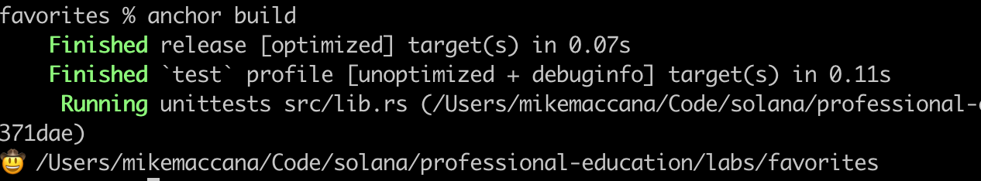
8. Build the project with
anchor build
Check your project compiles!

Slide 110
9. Make some tests part 1/4
Inside tests/favorites.ts, add:
import { assert } from "chai";
const web3 = anchor.web3;
Then replace the 'describe' function:
describe("Favorites", () => {
// Use the cluster and the keypair specified in Anchor.toml
const provider = anchor.AnchorProvider.env();
anchor.setProvider(provider);
const user = (provider.wallet as anchor.Wallet).payer;
const program = anchor.workspace.Favorites as Program<Favorites>;
// You can skip this 'before' section if you're busy!
// We don't need to airdrop if we're using the local cluster
// because the local cluster gives us 85 billion dollars worth of SOL
before(async () => {
const balance = await provider.connection.getBalance(user.publicKey);
const balanceInSOL = balance / web3.LAMPORTS_PER_SOL;
const formattedBalance = new Intl.NumberFormat().format(balanceInSOL);
console.log(`Balance: ${formattedBalance} SOL`);
});
continued on next slide...
Notes:
Anchor comes with an inbuilt copy of web3.js, so we can just do:
const web3 = anchor.web3;
Instead of importing it.
Most of our setup is just making Anchor use the settings in Anchor.toml, including a default user and a particular cluster to run the validator on.
Anchor projects are debugged on localhost. We don't need to airdrop to the local validator, but we've added a before() function here to show why!

Slide 111
10. Make some tests part 2/4
continued from previous slide
it("Saves a user's favorites to the blockchain", async () => {
// Here's what we want to write to the blockchain
const favoriteNumber = new anchor.BN(23);
const favoriteColor = "purple";
const favoriteHobbies = ["skiing", "skydiving", "biking"];
await program.methods
.setFavorites(favoriteNumber, favoriteColor, favoriteHobbies)
.signers([user])
.rpc();
// No check everything matches
const favoritesPdaAndBump = web3.PublicKey.findProgramAddressSync(
[Buffer.from("favorites"), user.publicKey.toBuffer()],
program.programId
);
const favoritesPda = favoritesPdaAndBump[0];
const dataFromPda = await program.account.favorites.fetch(favoritesPda);
assert.equal(dataFromPda.color, favoriteColor);
assert.equal(dataFromPda.number.toString(), favoriteNumber.toString());
assert.deepEqual(dataFromPda.hobbies, favoriteHobbies);
});
continued on next slide...

Slide 112
11. Make some tests part 4/4
continued from previous slide
it("Doesn't let people write to favorites for other users", async () => {
const someRandomGuy = anchor.web3.Keypair.generate();
try {
await program.methods
.setFavorites(new anchor.BN(420), "red", ["being a dork"])
.signers([someRandomGuy])
.rpc();
} catch (error) {
const errorMessage = (error as Error).message;
assert.isTrue(errorMessage.includes("unknown signer"));
}
});
Close the 'describe' block:
});
You've finished making your anchor tests!
Notes:
Let's also check that people can't write to other people's favorites—i.e., unless they're the signer, writing the favorites for our user should fail.

Slide 113
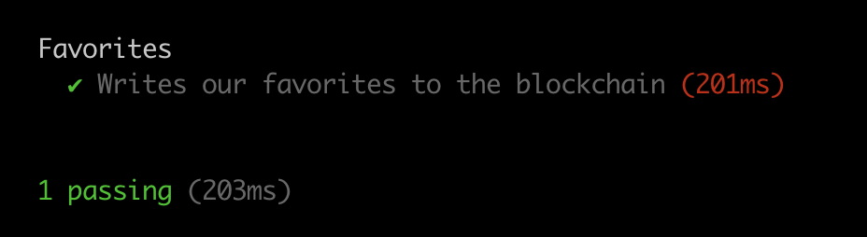
12. Run the tests with
anchor test
Ensure your tests pass!

Slide 114
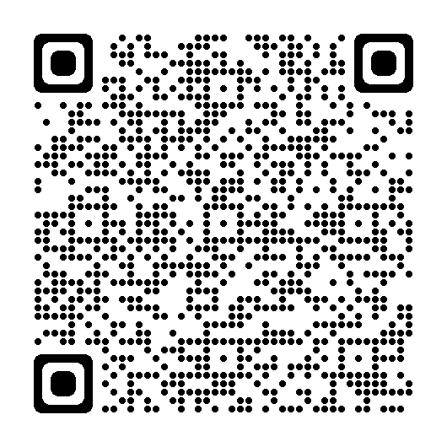
Lesson 6 feedback
Let us know what you think!

Slide 115
LESSON 7: USING ANCHOR WITH
TOKENS

Slide 116
Our next program allows a user to offer an amount of one token in exchange for an amount of another token.

Slide 117
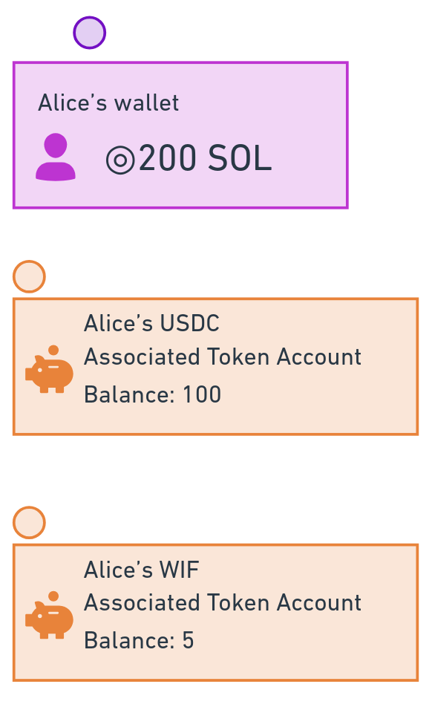
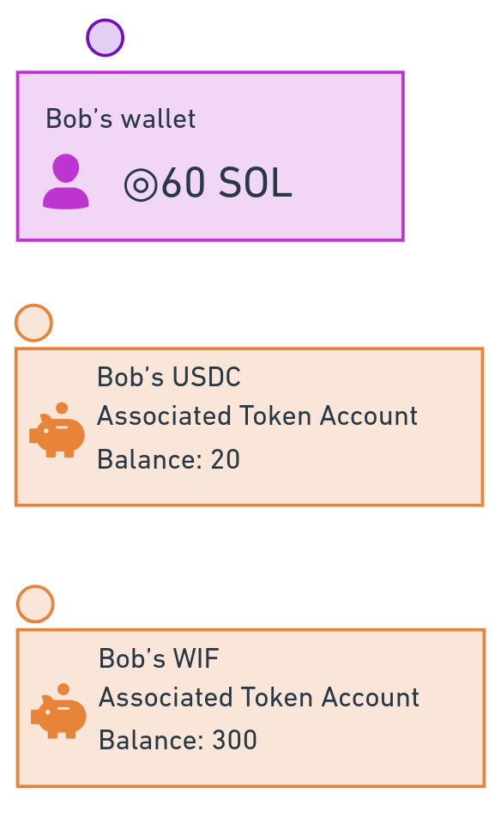
Alice has lots of USDC Bob has lots of WIF
Notes:
For example, Alice wants 100 WIF, and is offering to swap 10 USDC.
Without our program, the users would have to swap with each other manually.

Slide 118
Alice wants 100 WIF and is offering 10 USDC. Bob wants to take that offer. How can we ensure Alice and Bob don't run away with each other's tokens?
Notes:
What if Bob promised to send Alice 100 WIF but took the 10 USDC instead and ran? Or what if Alice was dishonest, received the 10 USDC, and decided not to send the 100 WIF?

Slide 119
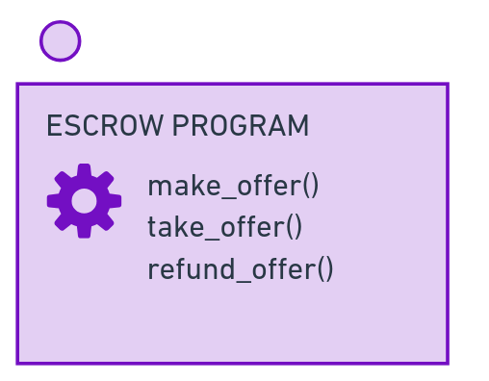
This is solved with an Escrow program!

Slide 120
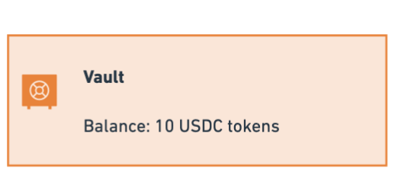
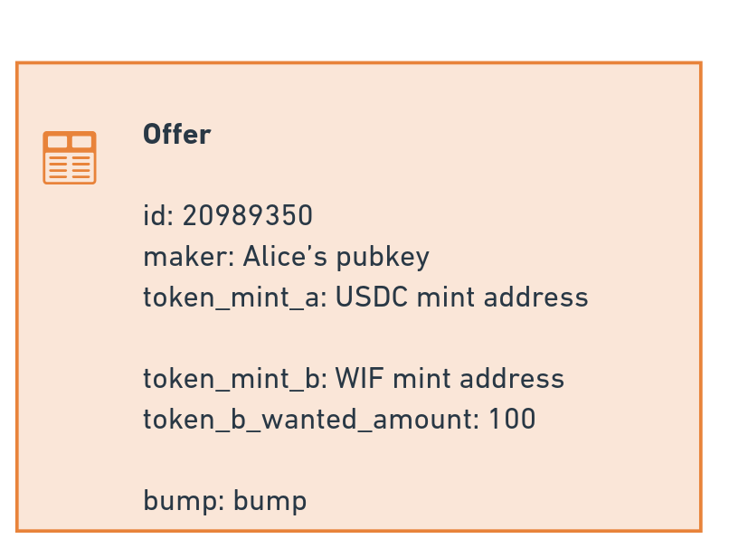
Our Escrow program will hold the funds provided by Alice, and store details of her offer.

Slide 121
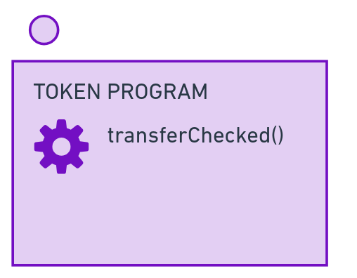
We'll also use the Token program to do the token transfers!
Notes:
When we add our Accounts struct, it will seem like a lot of accounts. But it's literally just the accounts you see in this diagram.

Slide 122
Terminology
This lab uses the following terms: maker The person that makes the Offer and puts their tokens into the vault. taker The person that takes the offer, and get the tokens in the vault in exchange for their own tokens.
token_a The token provided by the maker, and put into the vault.
token_b The token wanted by the maker, and hopefully provided by the taker.

Slide 123
LAB
ANCHOR AND TOKENS

Slide 124
1. Make a new anchor project, and run the default tests.
anchor init escrow --template=multiple
cd escrow
anchor test
Notes:
Make sure everything works out of the box before continuing. You may need to apply some of the fixes from the previous lab.

Slide 125
2. Add Anchor SPL, to use SPL tokens!
Open programs/escrow/Cargo.toml
[dependencies]
anchor-lang = { version = "0.30.0", features = ["init-if-needed"]}
anchor-spl = "0.30.0"
And also add this to the [features] sections
idl-build = ["anchor-lang/idl-build", "anchor-spl/idl-build"]
Open programs/escrow/src/constants.rs and add
pub const ANCHOR_DISCRIMINATOR: usize = 8;
Notes:
Anchor SPL allows us to use SPL tokens (anything other than SOL) in Anchor.

Slide 126
3. Create the Offer struct
Make programs/escrow/src/state/offer.rs
use anchor_lang::prelude::*;
#[account]
#[derive(InitSpace)]
pub struct Offer {
pub id: u64,
pub maker: Pubkey,
pub token_mint_a: Pubkey,
pub token_mint_b: Pubkey,
pub token_b_wanted_amount: u64,
pub bump: u8,
}
Also update programs/escrow/src/state/mod.rs
pub mod offer;
pub use offer::*;
Notes:
Create our Offer struct, which defines what an offer account will look like

Slide 127
4. Create our make_offer file!
Edit programs/escrow/src/instructions/mod.rs
pub mod make_offer;
pub use make_offer::*;
Create programs/escrow/src/instructions/make_offer.rs
use anchor_lang::prelude::*;
use anchor_spl::{
associated_token::AssociatedToken,
token_interface::{transfer_checked, Mint, TokenAccount, TokenInterface, TransferChecked},
};
use crate::{Offer, ANCHOR_DISCRIMINATOR};
continued on next slide...
Notes:
We're using the 'multiple files' template, which involves putting code related to each instruction handler into its own file rather than using lib.rs for everything.

Slide 128
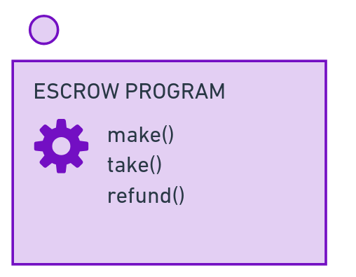
5. Add the MakeOffer accounts struct 1/2
programs/escrow/src/instructions/make_offer.rs
#[derive(Accounts)]
#[instruction(id: u64)]
pub struct MakeOffer<'info> {
#[account(mut)]
pub maker: Signer<'info>,
#[account(mint::token_program = token_program)]
pub token_mint_a: InterfaceAccount<'info, Mint>,
#[account(mint::token_program = token_program)]
pub token_mint_b: InterfaceAccount<'info, Mint>,
#[account(
mut,
associated_token::mint = token_mint_a,
associated_token::authority = maker,
associated_token::token_program = token_program
)]
pub maker_token_account_a: InterfaceAccount<'info, TokenAccount>,
continued on next slide...
Notes:
Create the accounts struct we'll make for MakeOffer.
The `instruction` macro allows our struct to access `id` from our instruction handler to set up the address for our `offer` account. These are the accounts we saw on the diagram earlier!

Slide 129
6. Add the MakeOffer accounts struct 2/2
programs/escrow/src/instructions/make_offer.rs continued (inside MakeOffer struct)
#[account(
init,
payer = maker,
space = ANCHOR_DISCRIMINATOR + Offer::INIT_SPACE,
seeds = [b"offer", maker.key().as_ref(), id.to_le_bytes().as_ref()],
bump
)]
pub offer: Account<'info, Offer>,
#[account(
init,
payer = maker,
associated_token::mint = token_mint_a,
associated_token::authority = offer,
associated_token::token_program = token_program
)]
pub vault: InterfaceAccount<'info, TokenAccount>,
pub associated_token_program: Program<'info, AssociatedToken>,
pub token_program: Interface<'info, TokenInterface>,
pub system_program: Program<'info, System>,
}
continued on next slide...

Slide 130
7. Create send_offered_tokens_to_vault()!
programs/escrow/src/instructions/make_offer.rs
pub fn send_offered_tokens_to_vault(
context: &Context<MakeOffer>,
token_a_offered_amount: u64,
) -> Result<()> {
let transfer_accounts = TransferChecked {
from: context.accounts.maker_token_account_a.to_account_info(),
mint: context.accounts.token_mint_a.to_account_info(),
to: context.accounts.vault.to_account_info(),
authority: context.accounts.maker.to_account_info(),
};
let cpi_context = CpiContext::new(
context.accounts.token_program.to_account_info(),
transfer_accounts,
);
transfer_checked(
cpi_context,
token_a_offered_amount,
context.accounts.token_mint_a.decimals,
)
}
continued on next slide...

Slide 131
8. Create save_offer()!
programs/escrow/src/instructions/make_offer.rs
pub fn save_offer(context: Context<MakeOffer>, id: u64, token_b_wanted_amount: u64) -> Result<()> {
context.accounts.offer.set_inner(Offer {
id,
maker: context.accounts.maker.key(),
token_mint_a: context.accounts.token_mint_a.key(),
token_mint_b: context.accounts.token_mint_b.key(),
token_b_wanted_amount,
bump: context.bumps.offer,
});
Ok(())
}

Slide 132
9. Update our lib.rs
Replace the entire 'mod' in programs/escrow/src/lib.rs:
#[program]
pub mod escrow {
use super::*;
pub fn make_offer(
context: Context<MakeOffer>,
id: u64,
token_a_offered_amount: u64,
token_b_wanted_amount: u64,
) -> Result<()> {
instructions::make_offer::send_offered_tokens_to_vault(&context, token_a_offered_amount)?;
instructions::make_offer::save_offer(context, id, token_b_wanted_amount)
}
}
continued on next slide...

Slide 133
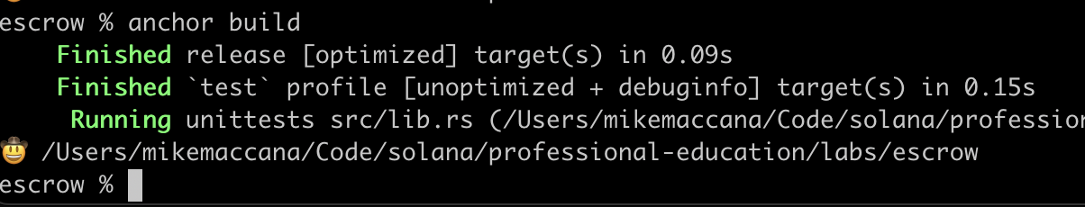
10. Check this compiles!
anchor build

Slide 134
11. Add some tests!
The test files involves a lot of set up Grab tests from https://github.com/solana-developers/professional-education/blob/main/labs/escrow/tests/escrow.ts Save to tests/escrow.ts
Comment out the take tests for now!

Slide 135
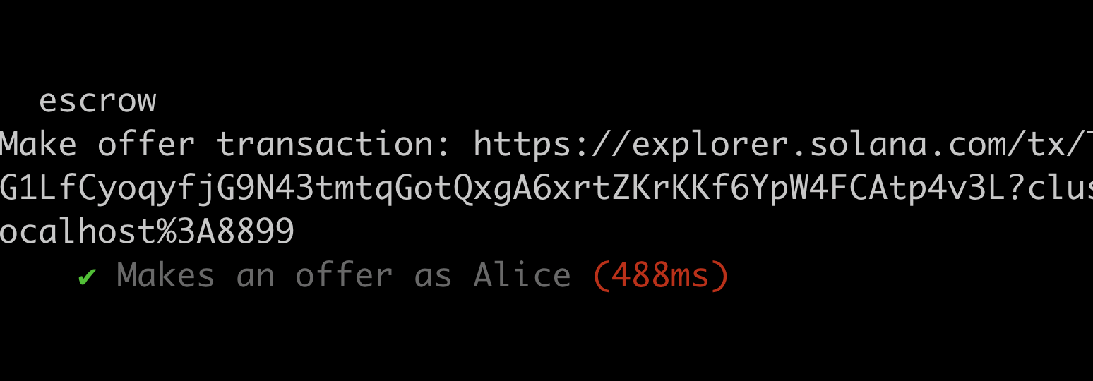
12. Run the tests with
anchor test
Ensure your tests pass!

Slide 136
13. Create our take_offer file!
Edit programs/escrow/src/instructions/mod.rs and add:
pub mod take_offer;
pub use take_offer::*;
Create programs/escrow/src/instructions/take_offer.rs
use anchor_lang::prelude::*;
use anchor_spl::{
associated_token::AssociatedToken,
token_interface::{
close_account, transfer_checked, CloseAccount, Mint, TokenAccount, TokenInterface,
TransferChecked,
},
};
use crate::Offer;
continued on next slide...

Slide 137
14. Create our TakeOffer accounts struct 1/3
programs/escrow/src/instructions/take_offer.rs continued
#[derive(Accounts)]
pub struct TakeOffer<'info> {
#[account(mut)]
pub taker: Signer<'info>,
#[account(mut)]
pub maker: SystemAccount<'info>,
pub token_mint_a: InterfaceAccount<'info, Mint>,
pub token_mint_b: InterfaceAccount<'info, Mint>,
#[account(
init_if_needed,
payer = taker,
associated_token::mint = token_mint_a,
associated_token::authority = taker,
associated_token::token_program = token_program,
)]
pub taker_token_account_a: Box<InterfaceAccount<'info, TokenAccount>>,
#[account(
mut,
associated_token::mint = token_mint_b,
associated_token::authority = taker,
associated_token::token_program = token_program,
)]
pub taker_token_account_b: Box<InterfaceAccount<'info, TokenAccount>>,
continued on next slide...

Slide 138
15. Create our TakeOffer accounts struct 2/3
programs/escrow/src/instructions/take_offer.rs continued (inside TakeOffer struct)
#[account(
init_if_needed,
payer = taker,
associated_token::mint = token_mint_b,
associated_token::authority = maker,
associated_token::token_program = token_program,
)]
pub maker_token_account_b: Box<InterfaceAccount<'info, TokenAccount>>,
#[account(
mut,
close = maker,
has_one = maker,
has_one = token_mint_a,
has_one = token_mint_b,
seeds = [b"offer", maker.key().as_ref(), offer.id.to_le_bytes().as_ref()],
bump = offer.bump
)]
offer: Account<'info, Offer>,
continued on next slide...

Slide 139
16. Create our TakeOffer accounts struct 3/3
programs/escrow/src/instructions/take_offer.rs continued (inside TakeOffer)
[account(
mut,
associated_token::mint = token_mint_a,
associated_token::authority = offer,
associated_token::token_program = token_program,
)]
pub vault: InterfaceAccount<'info, TokenAccount>,
pub associated_token_program: Program<'info, AssociatedToken>,
pub token_program: Interface<'info, TokenInterface>,
pub system_program: Program<'info, System>,
}
All finished!

Slide 140
17. Create send_wanted_tokens_to_maker()
programs/escrow/src/instructions/take_offer.rs continued
pub fn send_wanted_tokens_to_maker(ctx: &Context<TakeOffer>) -> Result<()> {
let transfer_accounts = TransferChecked {
from: ctx.accounts.taker_token_account_b.to_account_info(),
mint: ctx.accounts.token_mint_b.to_account_info(),
to: ctx.accounts.maker_token_account_b.to_account_info(),
authority: ctx.accounts.taker.to_account_info(),
};
let cpi_ctx = CpiContext::new(
ctx.accounts.token_program.to_account_info(),
transfer_accounts,
);
transfer_checked(
cpi_ctx,
ctx.accounts.offer.token_b_wanted_amount,
ctx.accounts.token_mint_b.decimals,
)
}
continued on next slide...

Slide 141
18. Create withdraw_and_close_vault() 1/2
programs/escrow/src/instructions/take_offer.rs continued
pub fn withdraw_and_close_vault(ctx: Context<TakeOffer>) -> Result<()> {
let signer_seeds: [&[&[u8]]; 1] = [&[
b"offer",
ctx.accounts.maker.to_account_info().key.as_ref(),
&ctx.accounts.offer.id.to_le_bytes()[..],
&[ctx.accounts.offer.bump],
]];
let accounts = TransferChecked {
from: ctx.accounts.vault.to_account_info(),
mint: ctx.accounts.token_mint_a.to_account_info(),
to: ctx.accounts.taker_token_account_a.to_account_info(),
authority: ctx.accounts.offer.to_account_info(),
};
let cpi_context = CpiContext::new_with_signer(
ctx.accounts.token_program.to_account_info(),
accounts,
&signer_seeds,
);
continued on next slide...

Slide 142
19. Create withdraw_and_close_vault() 2/2
programs/escrow/src/instructions/take_offer.rs continued (inside withdraw_and_close_vault)
transfer_checked(
cpi_context,
ctx.accounts.vault.amount,
ctx.accounts.token_mint_a.decimals,
)?;
let accounts = CloseAccount {
account: ctx.accounts.vault.to_account_info(),
destination: ctx.accounts.taker.to_account_info(),
authority: ctx.accounts.offer.to_account_info(),
};
let cpi_context = CpiContext::new_with_signer(
ctx.accounts.token_program.to_account_info(),
accounts,
&signer_seeds,
);
close_account(cpi_context)
}

Slide 143
20. Update lib.rs to add take_offer()
Now programs/escrow/src/lib.rs (inside the 'mod escrow')
pub fn take_offer(context: Context<TakeOffer>) -> Result<()> {
instructions::take_offer::send_wanted_tokens_to_maker(&context)?;
instructions::take_offer::withdraw_and_close_vault(context)
}

Slide 144
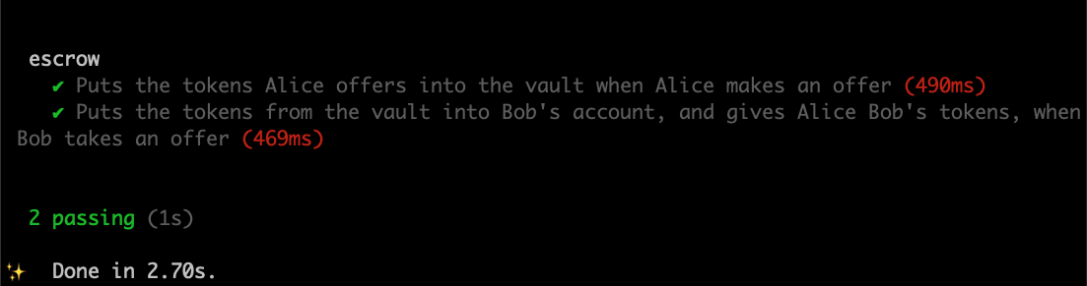
21. Run the tests again!
anchor test
Uncomment the 'take' tests and then...

Slide 145
Lesson 7 feedback
Let us know what you think!

Slide 146

THANKS!

Slide 147
Further info
X (Twitter): @solana_devs
NY Solana: @getofflinexyz
Solana ecosystem accounts: @0xmert_, @trentdotsol, @bangerzNFT, @mikemaccana
Rust: The Rust Programming Language
Anchor: https://book.anchor-lang.com
Examples: https://github.com/solana-developers/program-examples

